Slide 1
numerical computation

Slide 2
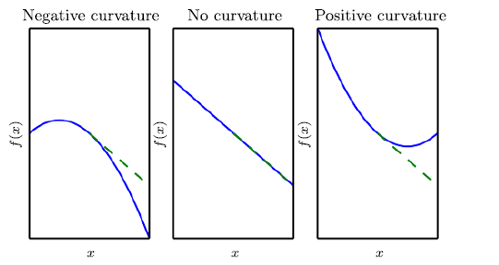
why 2nd derivative: curvature

Slide 3
dimensions are confusing

Slide 4
an example for the whiteboard
we can calculate the gradient
we can calculate the Hessian (Jacobian of gradient)

Slide 5
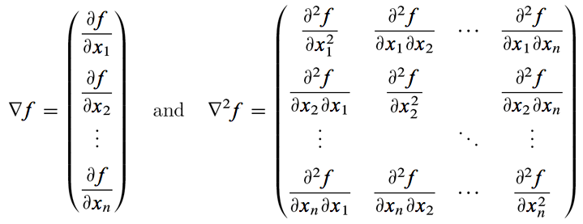
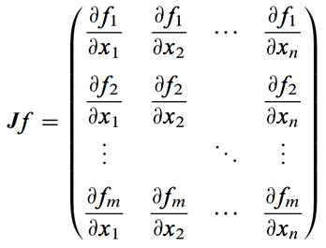
http://www.value-at-risk.net/functions/

Slide 6
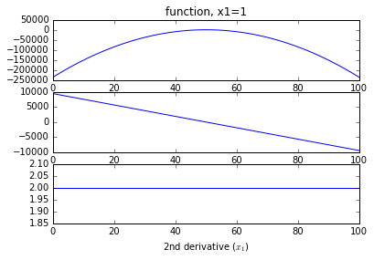
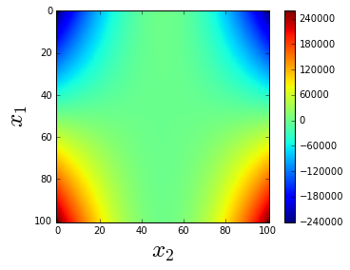
function

Slide 7

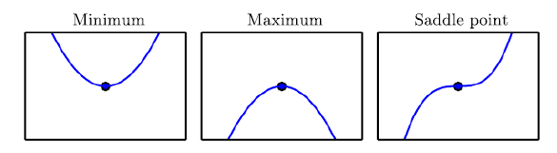
why using 2nd derivative
determine step size
determine local max, local min, saddle point
Hessian: if eigenvalues are pos & neg → saddle point

Slide 8
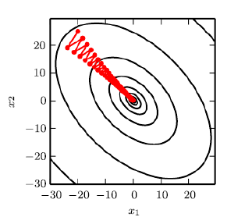
why using 2nd derivative
gradient descent does not know where to explore → Newtons method; 2nd order optimization

Slide 9
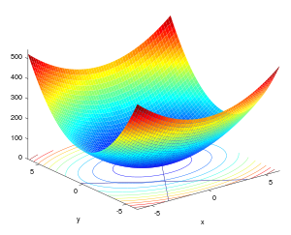
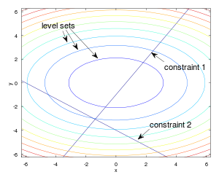

constrained optimisation
goal: restrict your x (parameters) to feasible values e.g,. learning rate α: [0,1]
efficient encoding: within the optimisation function
Karush-Kuhn-Tucker (KKT); generalized Lagrangian
equality contraints g(x)=0
inequality constraints h(x)≤0

Slide 10

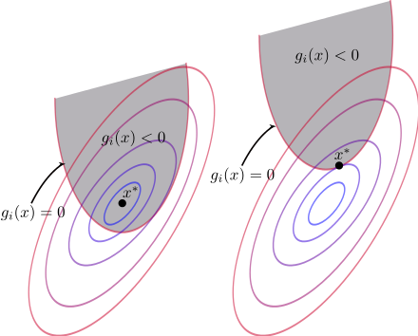
constrained optimisation
then minimum is within constraints, then
e.g,. learning rate α: [0,1]

